Slide 2
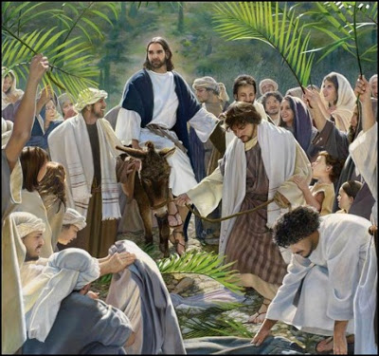
“Hosanna to the Son of David!” “Blessed is he who comes in the name of the Lord!” “Hosanna in the highest!” Matthew 21:9

Slide 4
Matthew 26:36-46 Mark 14:32-42 Luke 22:39-46 John 18:1

Slide 5
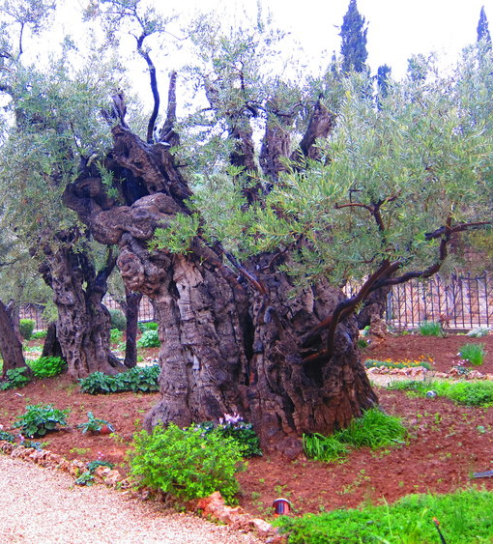
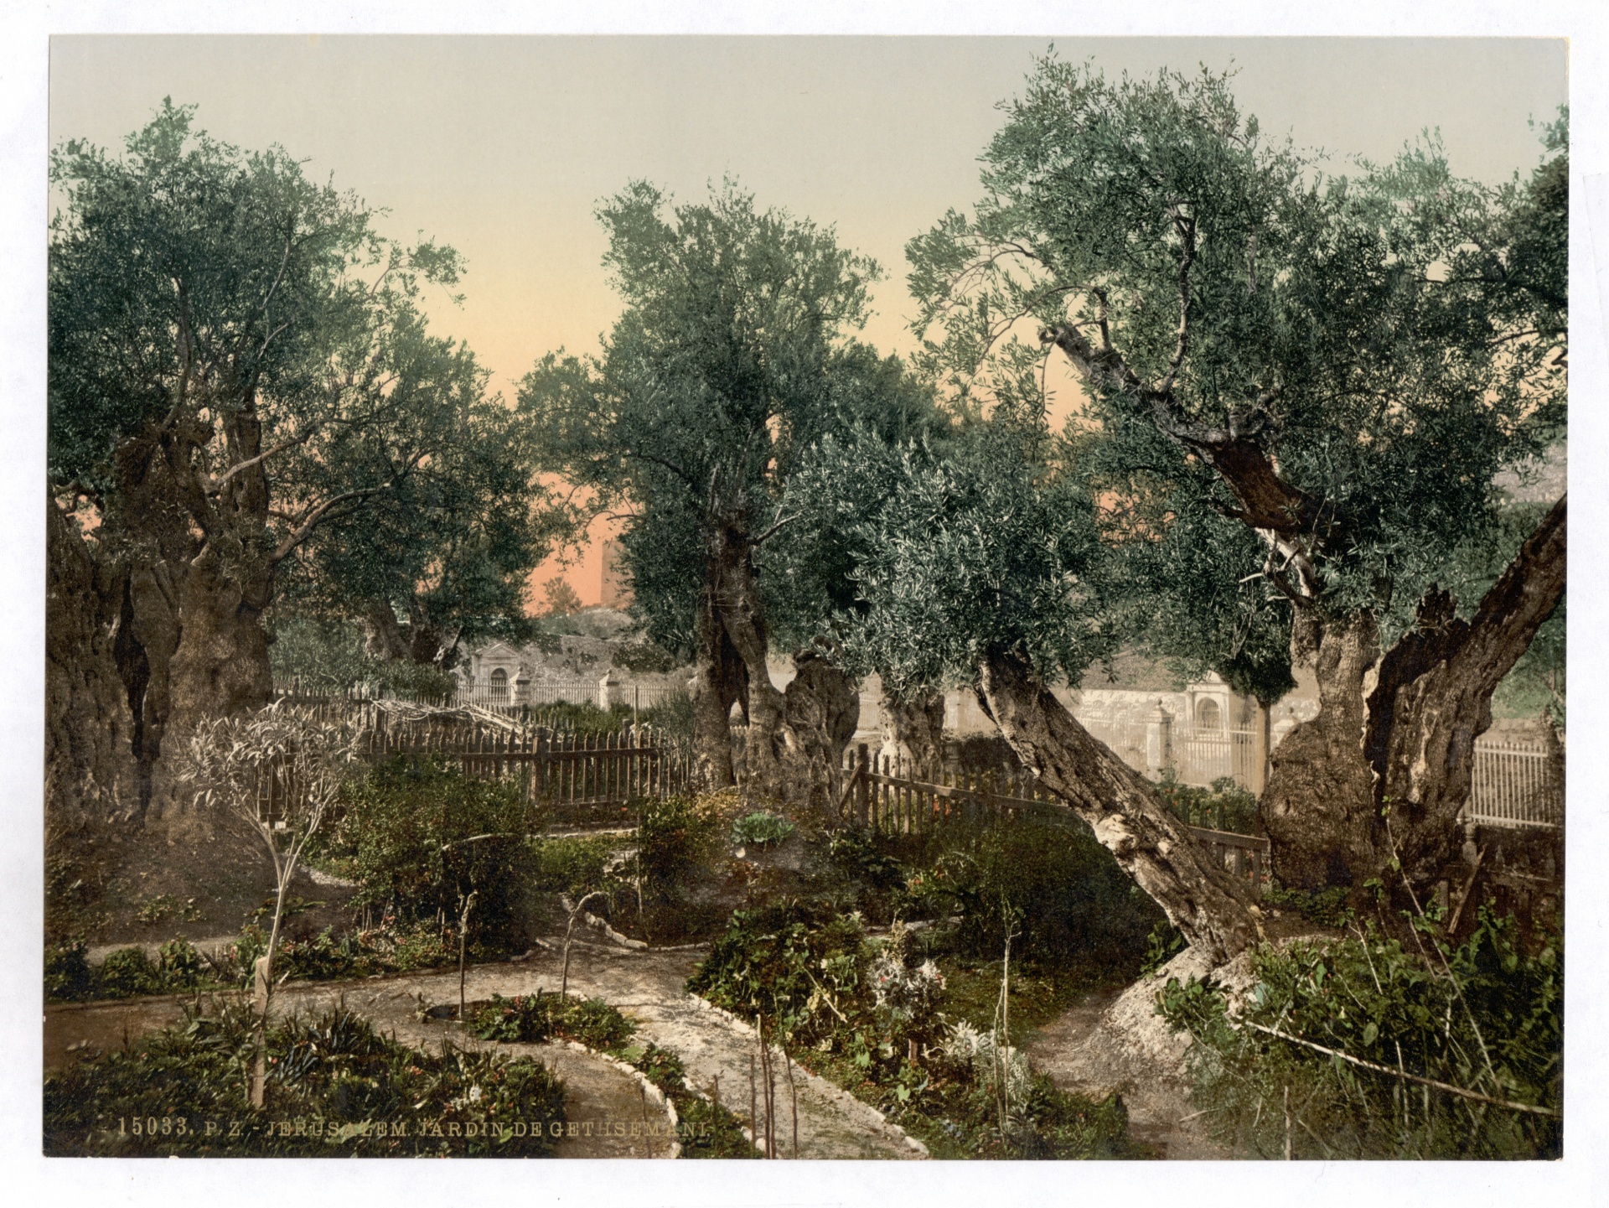
Garden of Gethsemane

Slide 6
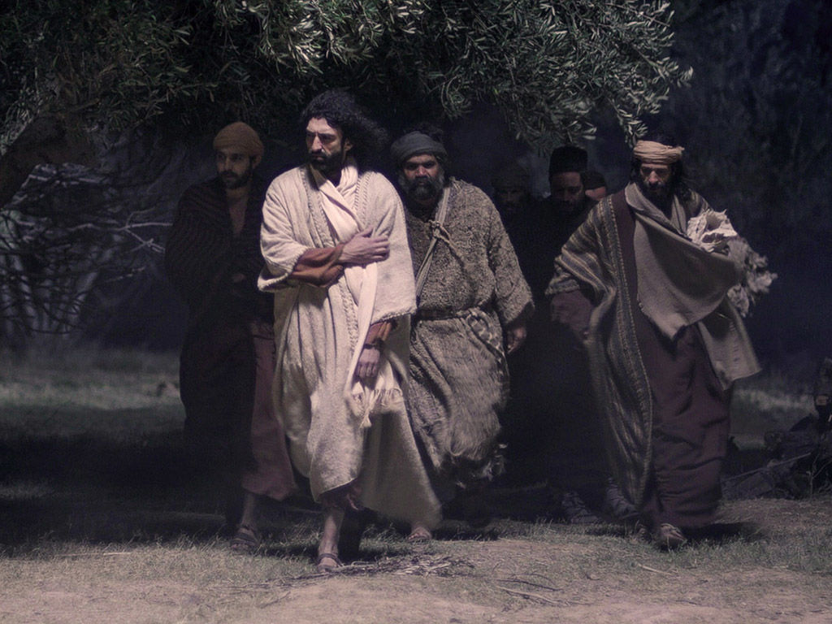
Jesus needed physical support

Slide 7
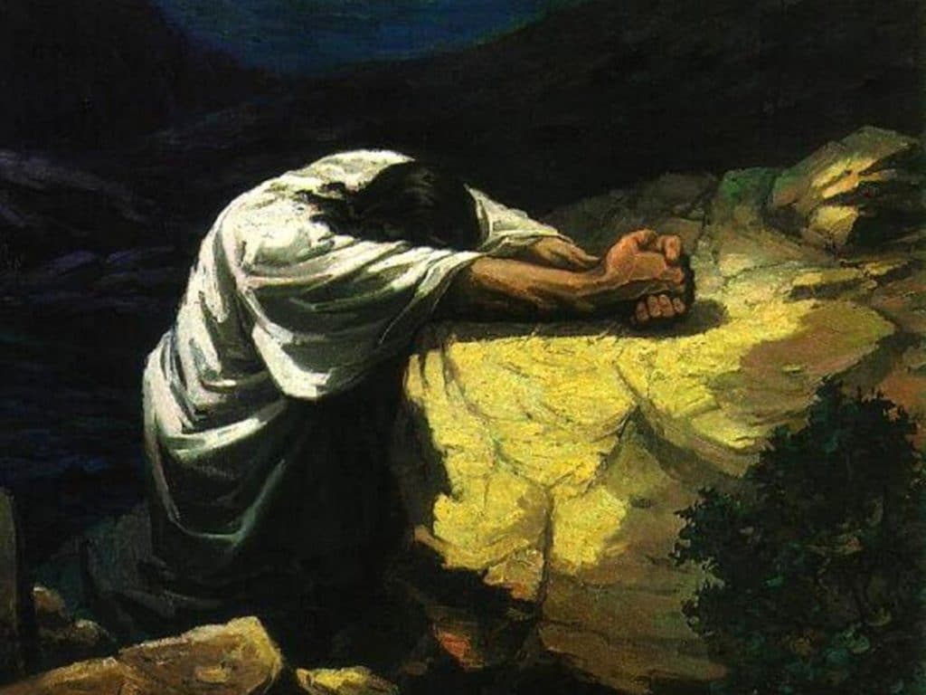
Jesus had spiritual needs

Slide 8
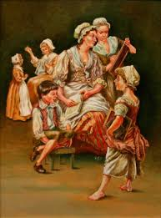

Slide 9
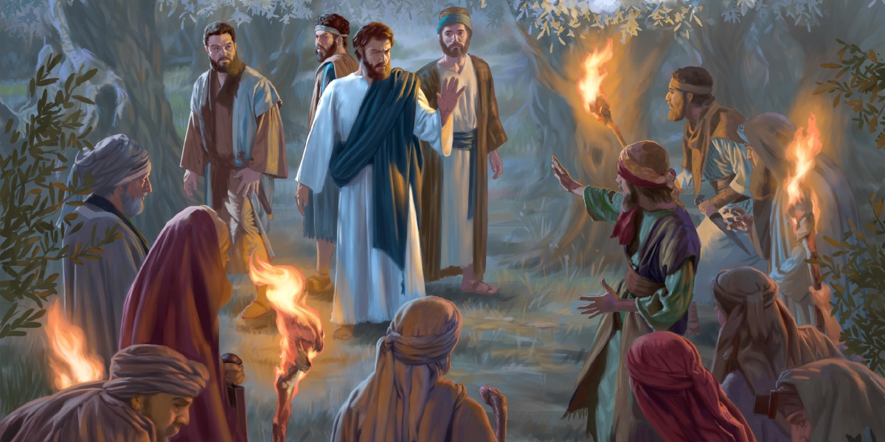
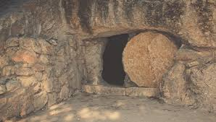
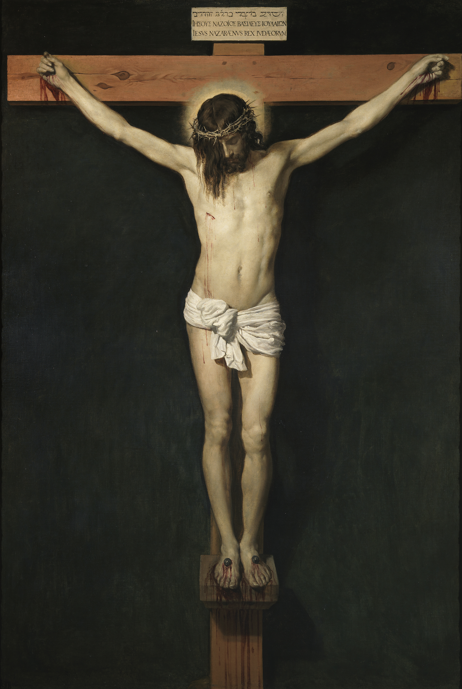
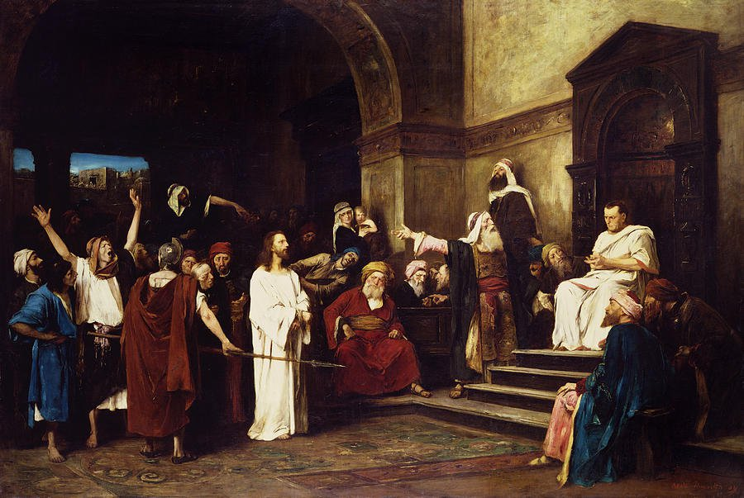
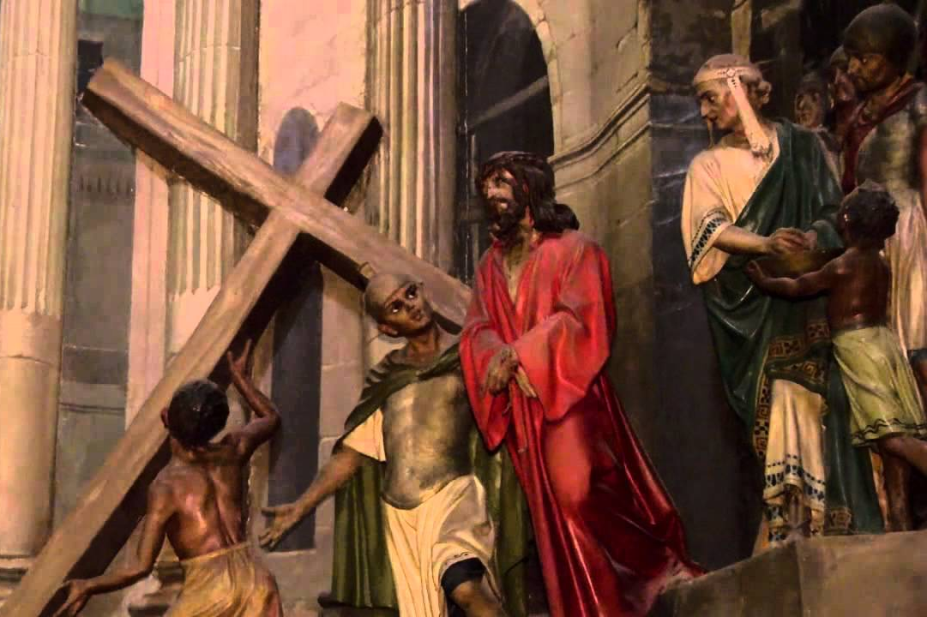
“Father if you are willing , take this cup from me, yet not my will but yours be done” Luke 22:42

Slide 10
We have friends to share the journey We have a God who cares for us and longs for us to talk to him in prayer We have a Holy Spirit who speaks to us as we read God’s Word

